Slide 1

Estonia Network Debacle
Massive Estonian Web Failure in 2007

Slide 2
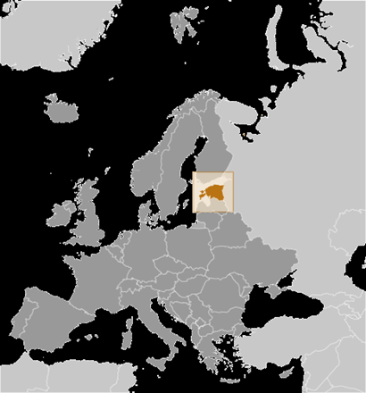
Overview of Estonia
Location: Europe - Bordered by Finland (North), Latvia (South) and Russia (East)
Capital City: Tallinn
Gained Independence in 1918
Forced into the Soviet Union in 1940
Regained freedom in 1991
Cyber Attack in 2007

Slide 3
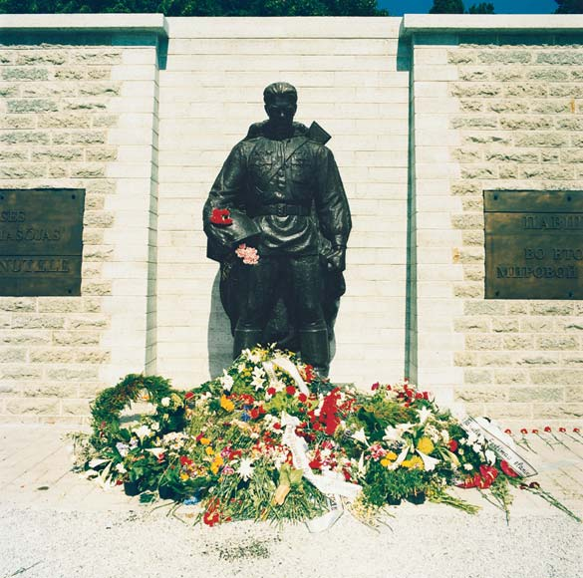

The Monument
Estonia Debacle in 2007
Moving of the 6ft tall bronze monument - built by the Soviet Union
Lead to Riots
Welcome to Web War I
When? April 27th to May 18th 2007
What happened? DDOS launched on government agencies, banks, corporate websites
Who were responsible?
How did they overcome the attack?

Slide 4
Cybercrime or Information Warfare?
Cybercrime
Information Warfare
Cybercrimes are malicious acts done to an individual or a group of individuals
Information warfare is the gathering and analysis of data to be used offensively
Stupples, D. (2015). What is information warfare. Retrieved from https://www.weforum.org/agenda/2015/12/what-is-information-warfare/

Slide 5
Cyber Warfare?
Cyberwarfare are malicious acts that may be politically motivated and affects people on a large scale
Tripathi, S. (n.d.). Difference between cyber crime and cyber warfare and advantages attackers have. Retrieved from https://shivatripathi.wordpress.com/2014/12/24/difference-between-cyber-crime-and-cyber-warfare-and-advantages-attackers-have/

Slide 6
What was the nature of the attack?
The attack took the form of several waves of Distributed Denial of Service (DDoS) attacks, targeted at government agencies and banks.
DDoS involves flooding a server with packets of data in order to cause users to either lose connectivity or have extremely long delays when communicating to the server.
Schmidt, A. (2013). The Estonian Cyberattacks

Slide 7
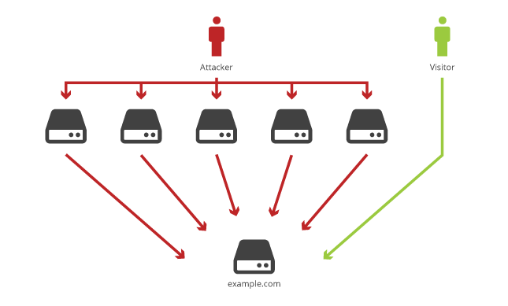
Layout of how a typical DDoS works

Slide 8
How were they implemented?
The attacks were spread out over a period of weeks starting from Friday, April 27th, 2007.
Happened in two phases:
First phase was carried out by persons having to manually run the codes and scripts, that were posted to online forums, to perform the DDoS attacks.
Initial attacks were targeted mostly on Government ministries and organizations.
Schmidt, A. (2013). The Estonian Cyberattacks

Slide 9
Second phase the attacker/s started implementing bots to help increase attack intensity.
Attacks now included banks along with Government ministries and organizations.
These attacks continued until they eventually ceased on May 18th, 2007
McGuinness, D. (2017, April 27). How a cyber attack transformed Estonia. Retrieved from http://www.bbc.com/news/39655415

Slide 10
What can be done locally and internationally to prevent such attacks in the future?

Slide 11
What was done in Estonia
Estonia’s Computer Emergency Response Team (CERT)
North Atlantic Treaty Organization (NATO)
Cyber defense research center in Tallinn
Estonia call on the EU to make cyber-attacks a criminal offense.

Slide 12
Cyber Prevention in Guyana
Establish Cybercrime Unit
Cybercrime bill 2016
What more?
Regionally
Internationally

Slide 13
International Cyber-Attack Prevention
Things you need to understand
First: Understand the Why/How cyberattacks are possible
Second: Understand the possible threats
Third: Understand what is the international legislation

Slide 14
International Cyber-Attack Prevention
The Possible Threats
DDoS (Distributed Denial of Service)
Eavesdropping: Using Packet Sniffers to observe patterns of traffic
Spoofing
Injecting Malicious Code
And many more…

Slide 15
International Cyber-Attack Prevention
The Actual Thing
Internationally accepted and endorsed legislation
Restrictions on government web resources
Cyber Security Assistance

Slide 16
References
Schmidt, A. (2013). The Estonian Cyberattacks
McGuinness, D. (2017, April 27). How a cyber attack transformed Estonia. Retrieved April 15, 2018, from http://www.bbc.com/news/39655415
Heickerö, R. (2010). Emerging cyber threats and Russian views on information warfare and information operations. Stockholm: FOI, Swedish Defence Research Agency, Division of Defence Analysis

Slide 17
Tripathi, S. (n.d.). Difference between cyber crime and cyber warfare and advantages attackers have. Retrieved from https://shivatripathi.wordpress.com/2014/12/24/difference-between-cyber-crime-and-cyber-warfare-and-advantages-attackers-have/
Stupples, D. (2015). What is information warfare. Retrieved from https://www.weforum.org/agenda/2015/12/what-is-information-warfare/

Slide 18

Group Members:
Dwight Ferguson
Shemar Austin
Kim Shing Chong
Farnaz Baksh
Shomari Williams

